Slide 1


Welcome you all
JAVA PROGRAMMING
DAY : 9
D.Sakthivel
Assistant Professor & Trainer,
KGiSL Micro College
KGiSL Campus, Coimbatore – 641 035.

Slide 2
Day- 9
Java Package
What is Package?
Built in Package
User-Defined Package

Slide 3
Packages
A java package is a group of similar types of classes, interfaces and sub-packages.
Package in java can be categorized in two form, built-in package and user-defined package.
There are many built-in packages such as java, lang, awt, javax, swing, net, io, util, sql etc.

Slide 4
Packages
A java package is a group of similar types of classes, interfaces and sub-packages.
Package in java can be categorized in two form, built-in package and user-defined package.
There are many built-in packages such as java, lang, awt, javax, swing, net, io, util, sql etc.
Advantage of Java Package
1) Java package is used to categorize the classes and interfaces so that they can be easily maintained.
2) Java package provides access protection.
3) Java package removes naming collision.

Slide 5
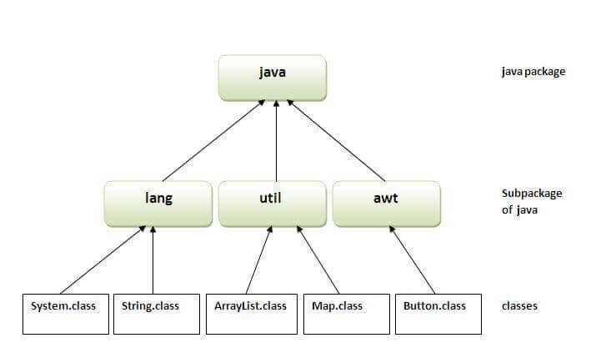
Packages

Slide 6
Simple example of java package
The package keyword is used to create a package in java.
//save as Simple.java
package mypack;
public class Simple{
public static void main(String args[]){
System.out.println("Welcome to package");
}
}
How to compile java package
For example
javac -d . Simple.java
The -d switch specifies the destination where to put the generated class file. You can use any directory name like /home (in case of Linux), d:/abc (in case of windows) etc.
If you want to keep the package within the same directory, you can use . (dot).

Slide 7
How to run java package program
You need to use fully qualified name e.g. mypack.Simple etc to run the class.
To Compile: javac -d . Simple.java
To Run: java mypack.Simple
The -d is a switch that tells the compiler where to put the class file i.e. it represents destination. The . represents the current folder.

Slide 8
How to access package from another package?
There are three ways to access the package from outside the package.
import package.*;
import package.classname;
fully qualified name.
1) Using packagename.*
If you use package.* then all the classes and interfaces of this package will be accessible but not subpackages.
The import keyword is used to make the classes and interface of another package accessible to the current package.

Slide 9

Example of package that import the packagename.*
//save by A.java
package pack;
public class A{
public void msg(){System.out.println("Hello");}
}
//save by B.java
package mypack;
import pack.*;
class B{
public static void main(String args[]){
A obj = new A();
obj.msg();
}
}

Slide 10

2) Using packagename.classname
If you import package.classname then only declared class of this package will be accessible.
Example of package by import package.classname
//save by A.java
package pack;
public class A{
public void msg(){System.out.println("Hello");}
}
//save by B.java
package mypack;
import pack.A;
class B{
public static void main(String args[]){
A obj = new A();
obj.msg();
}
}

Slide 11
3) Using fully qualified name
If you use fully qualified name then only declared class of this package will be accessible. Now there is no need to import.
But you need to use fully qualified name every time when you are accessing the class or interface.
It is generally used when two packages have same class name e.g. java.util and java.sql packages contain Date class.

Slide 12
3) Using fully qualified name
//save by A.java
package pack;
public class A{
public void msg(){System.out.println("Hello");}
}
//save by B.java
package mypack;
class B{
public static void main(String args[]){
pack.A obj = new pack.A();//using fully qualified name
obj.msg();
}
}

Slide 13
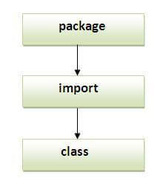
Note: Sequence of the program must be package then import then class.

Slide 14
Sub package in java
Package inside the package is called the subpackage. It should be created to categorize the package further.
Let's take an example, Sun Microsystem has definded a package named java that contains many classes like System, String, Reader, Writer, Socket etc.
These classes represent a particular group e.g.
Reader and Writer classes are for Input/Output operation, Socket and ServerSocket classes are for networking etc and so on.
So, Sun has subcategorized the java package into subpackages such as lang, net, io etc. and put the Input/Output related classes in io package, Server and ServerSocket classes in net packages and so on.

Slide 15

Example of Sub package
package com.javatpoint.core;
class Simple{
public static void main(String args[]){
System.out.println("Hello subpackage");
}
}
To Compile: javac -d . Simple.java
To Run: java com.javatpoint.core.Simple

Slide 16



Thank You

